Slide 1
Lake County Safety Expo What Keeps You Up at Night?
Classroom H-1095
Notes:
On screen as people come in

Slide 2
Your Speakers
Bob Bradley, 30 year Occupational Health and Safety Professional. Currently Bob is the Health, Safety and Environmental Specialist for US Endoscopy and has been with the organization for 8 years. US Endoscopy is a local medical device manufacturer employing 430 people.
Tobin Hawes, 27 years in manufacturing in roles such as New Product Development, Plant Engineer, Maintenance Manager and Safety, Health and Environmental Manager. Currently Tobin is the SHE Manager for Henkel Consumer Adhesives in Mentor and supports sites in Cleveland, Westlake and LaGrange, GA. Henkel employs more than 50,000 people worldwide.
Notes:
Someone from the Safety Council will introduce

Slide 3
What Keeps You Up at Night?
Notes:
Bob – “Welcome everyone, glad you could make it to the show. I am also glad that there are enough companies in Lake County that are safety conscious enough that we can muster support to put on an expo like this.”
“So…what keeps you up at night, anyone?”
“Show of hands, who has had an OSHA visit in the last 12 months?”
If hands, ask “What was the visit like?”
“What fears went through your mind?”
“How did you handle it?”
Use your judgment and ask leading questions to draw out the information. Be sure to ask the group if anyone else experienced this and what they did.
If no hands, I will speak up and you can ask the same questions of me.

Slide 4
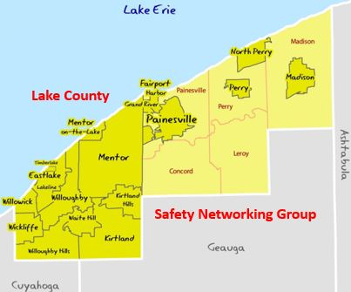
Lake County Safety Networking Group
Founded in 2015 Meets Bi-Monthly
Notes:
Bob to give the history of this group

Slide 5
What Keeps You Up at Night?
OSHA Visit
Permitting
Contractor Safety
Recordkeeping
Ladders
Safety Committee
Industrial Hygiene
Case Management
Incident Investigation
Chemical Spill
OSHA National Emphasis Programs
Safety Initiatives, recognition
Safety Training
Notes:
Tobin – “What keeps you up at night?”
“Do any of these topics raise a concern for anyone?” “Anybody want to talk about it?”
If hands, pursue the topic with leading questions. Ask how others handled.
If no hands, Bob will volunteer – “I have a roofing project going on right now. I am very concerned on making sure everyone is safe including the contractors while this is going on.”

Slide 6
What Keeps You Up at Night?
Notes:
Bob - "What keeps you up at night"
If hands, pursue the topic with leading questions. Ask how others handled.
If no hands, ask "Anybody have any pesky Worker's Compensation issues?"
If hands, pursue the topic with leading questions. Ask how others handled.
If no hands Tobin will speakup.

Slide 7
OSHA Emphasis Programs
National
Local (Region V)
Primary Metals Industry
Hazardous Machinery - Amputations
Trenching and Excavation
Combustible Dust
Silica
Isocyanates
Lead Hexavalent Chromium
PSM Covered Facilities
Ship Breaking
Building Renovation/Rehabilitation and Demolition
Powered Industrial Vehicles
Fall Hazards in Construction and General Industry
Dairy Farm Operations
Grain Handling Facilities
Tree Trimming Operations
Wood Pallet Manufacturing Industry
Maritime Industries
Lead & Silica
Notes:
Tobin - "Show of hands, do any of you fall into any of these industries?"
"Did you know that OSHA has them listed as Special Emphases Programs?"
"Anybody concered or loosing sleep over any of this programs?"

Slide 8
Behavioral Based Safety
Notes:
Tobin - "Hey Bob, do you know anything about the BBS stuff?" "My boss says that we need to put some kiind of BBS program in play." "What is it an how does it work?"

Slide 9
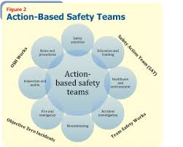
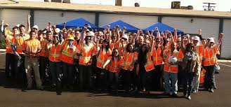
Safety Teams
Notes:
Bob - "Tobin, do you have a Safety Team?" "How does yours work because mine is ineffective and nobody wants to do anything yet alone show up for the meetings."

Slide 10
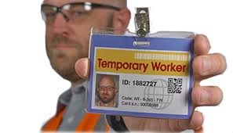
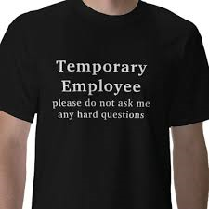
Temporary Worker Initiative

Slide 11
Thank You
Next Meeting
Thursday, May 26, 2016 – 7:30 to 8:30AM – Scrambler Marie’s – Mentor
Bob Bradley – 440-358-6566 or 724-396-9091
Tobin Hawes – 440-205-3933 or 216-816-8350
Visit the LinkedIn Group: https://www.linkedin.com/groups/8470463
Please leave you name and contact details if you want us to contact you.

